Slide 1

CROP MONITORING SYSTEM
TEAM QUINTET
Abhirami B
Gayathri R Beeji
Manassa J
Revathy Jayakumar
Rincy Roy

Slide 2
INTRODUCTION
Lifestyle of people is changing due to growth of Technology.
In this fast moving world , people are more attached to smart Technologies.
Network based smart plant monitoring system that control plant’s health status , provide humidity range , moisture level and temperature of soil along with a pumping system.
OBJECTIVES
TO SAVE WATER AND REDUCE HUMAN INTERVENTION IN THE AGRICULTURE FIELD.
TO GET OUTPUT OF SOIL WATER SENSOR AND PROVIDE WATER TO CROP.

Slide 3

A SCENARIO IN WHICH OBJECTS, ANIMALS OR PEOPLE ARE PROVIDED WITH UNIQUE IDENTIFIERS AND THE ABILITY TO CONTROL AND TRANSFER DATA OVER A NETWORK WITHOUT REQUIRING DIRECT INTERACTION.

Slide 4
CROP MANAGEMENT USING IOT
Application of IOT in which controlling of farming is done using various internet based control techniques.
A crop management system will sense humidity , moisture and temperature of the soil .
Includes sending information about the same to user and watering the plant according to the range of soil moisture.
To implement crop management system using IOT we need:-
A internet connected MCU connected to the devices
An application called Blynk is used
A smart phone for the user to interact with the system

Slide 5
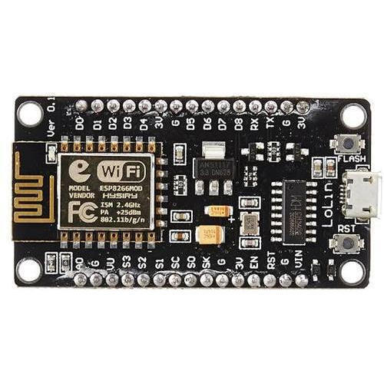
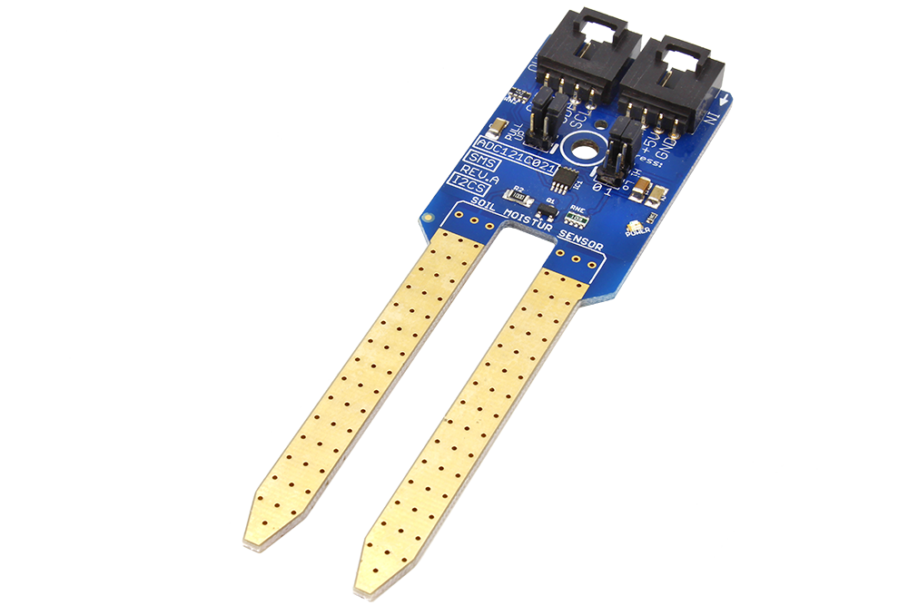
THINGS REQUIRED
Hardware devices
Nodemcu ESP8266
Soil Moisture Sensor

Slide 6
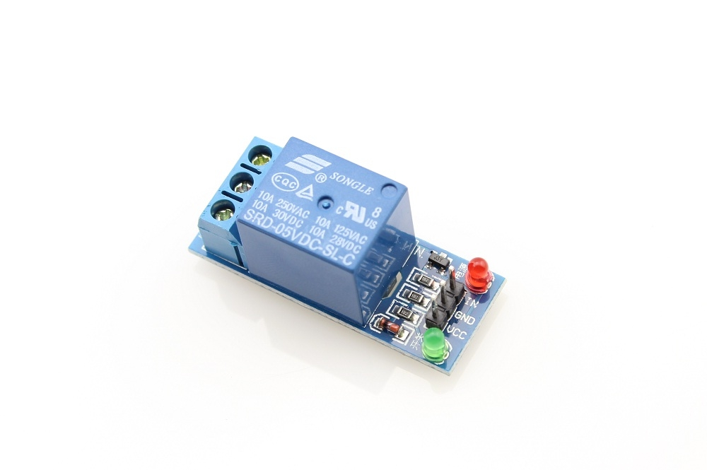
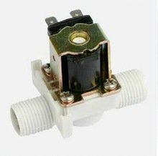

Relay Module ​
Solenoid Water Valve
12V Battery

Slide 7
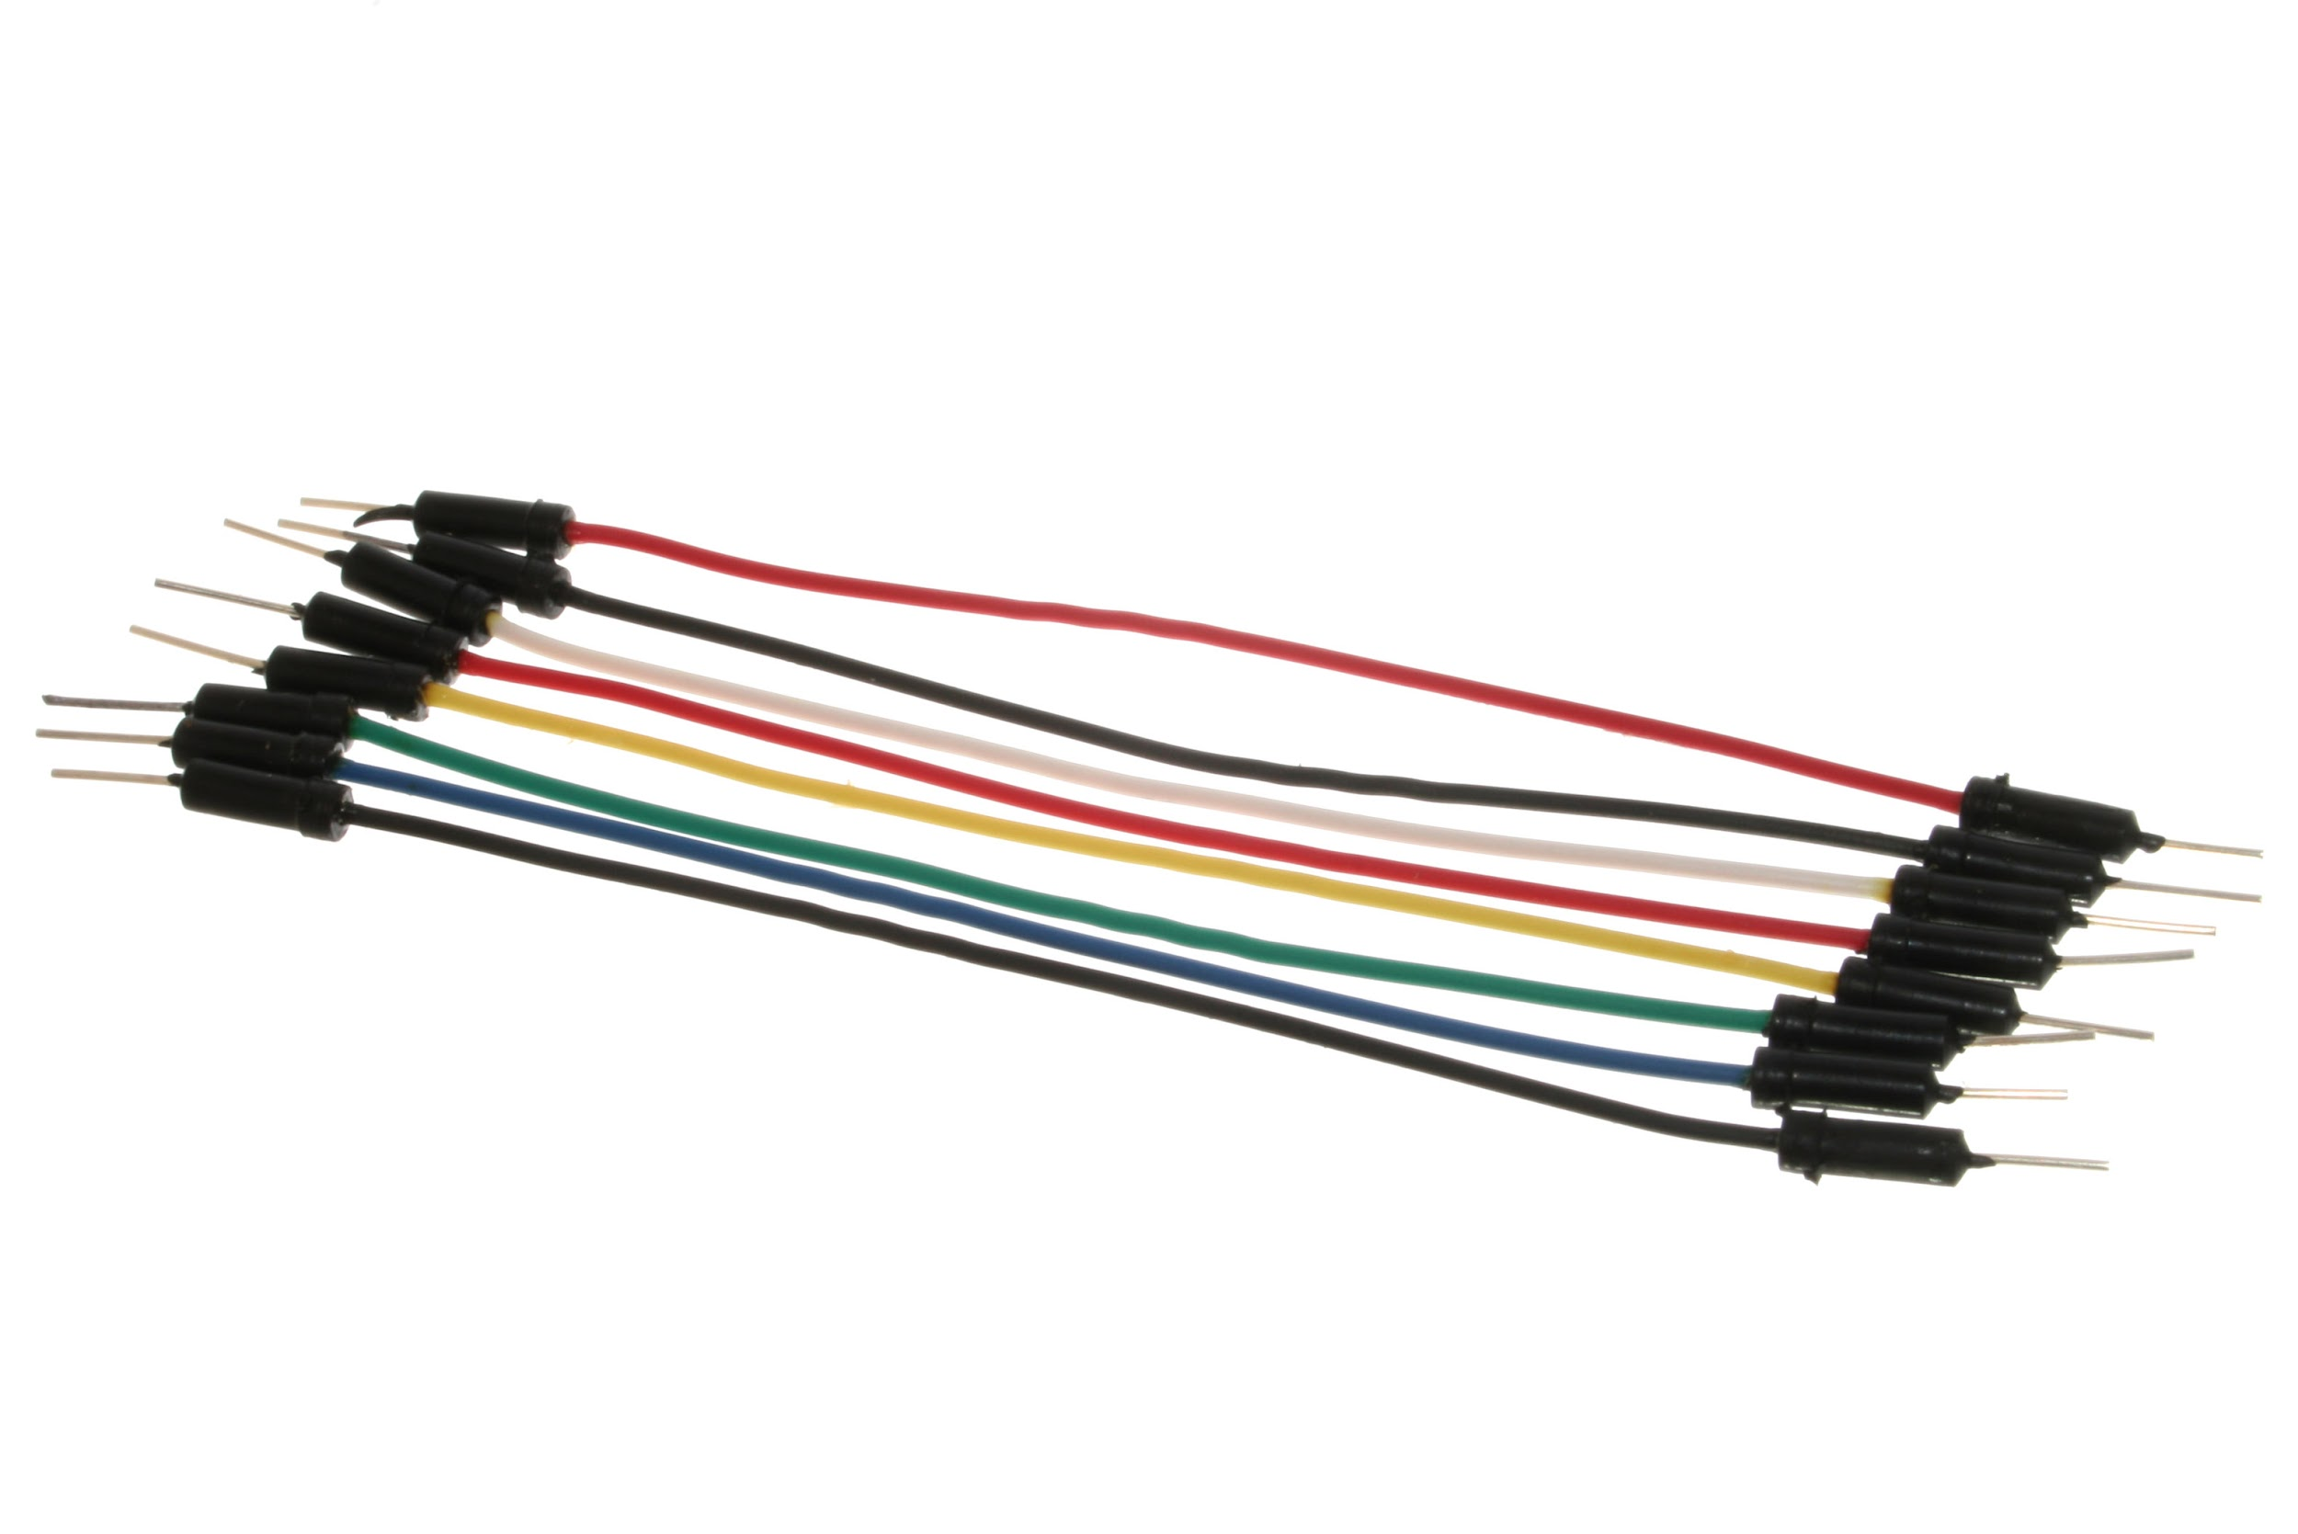
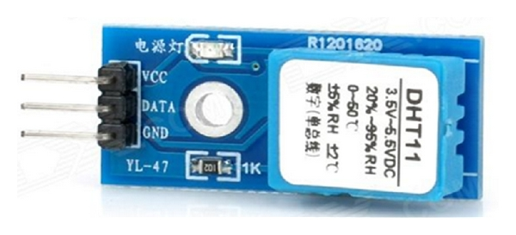
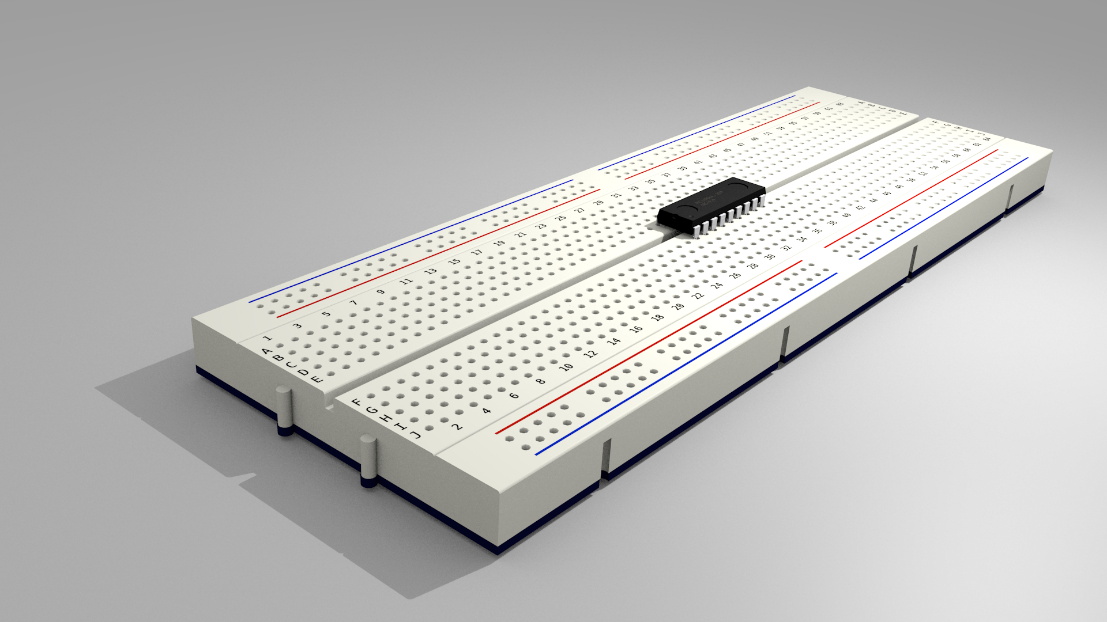
Jumper Wires
DHT 11
Breadboard

Slide 8


Software components
Blynk
Arduino IDE

Slide 9
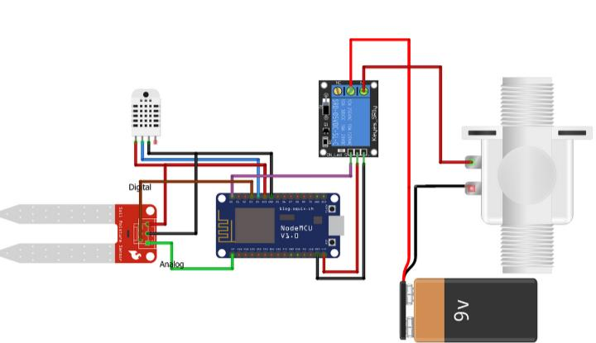
CIRCUIT DIAGRAM

Slide 10

WORKING

Slide 11
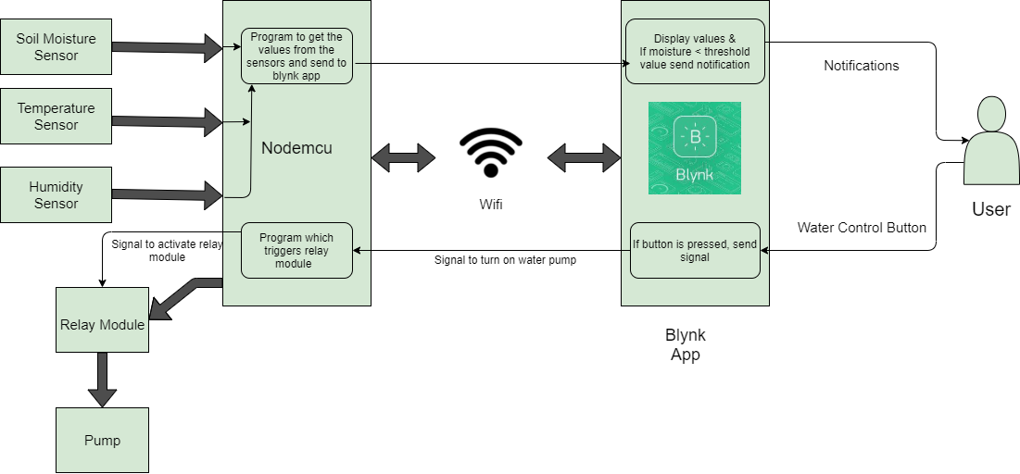
SYSTEM ARCHITECTURE

Slide 12
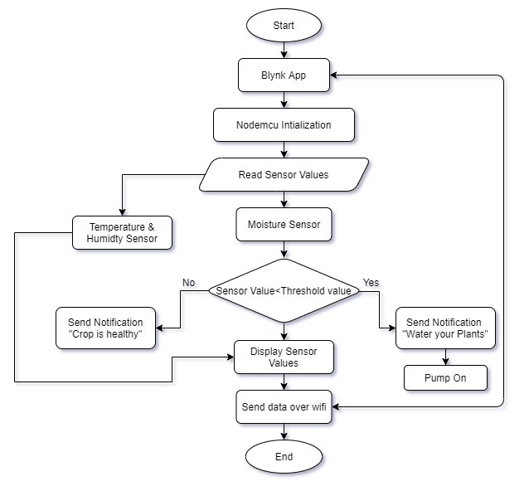
FLOW CHART

Slide 13
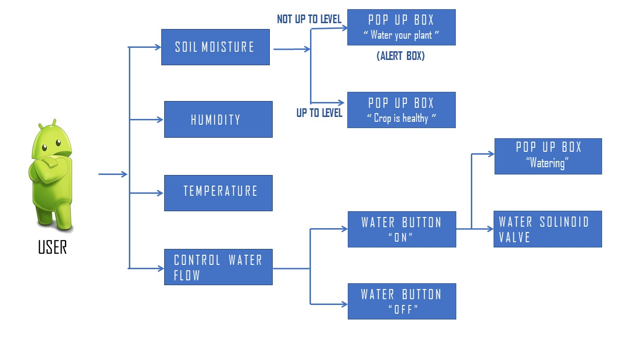
FRONT END

Slide 14
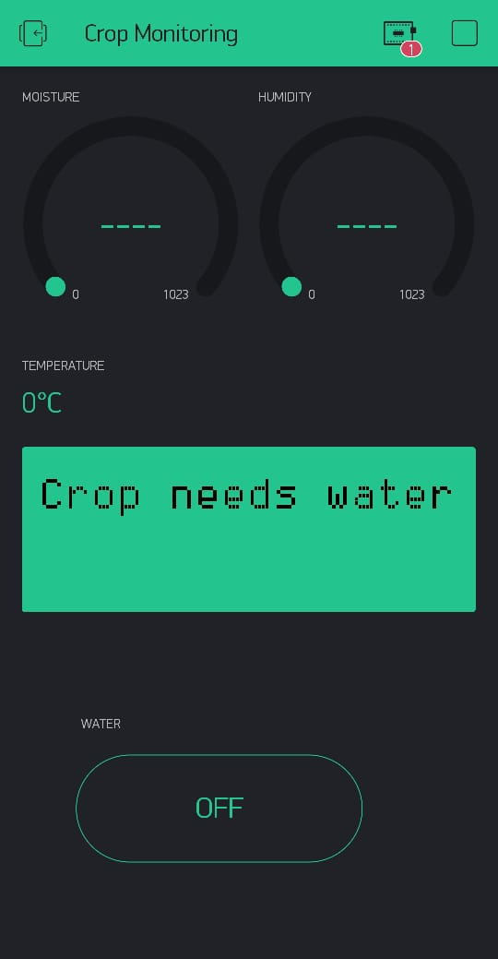
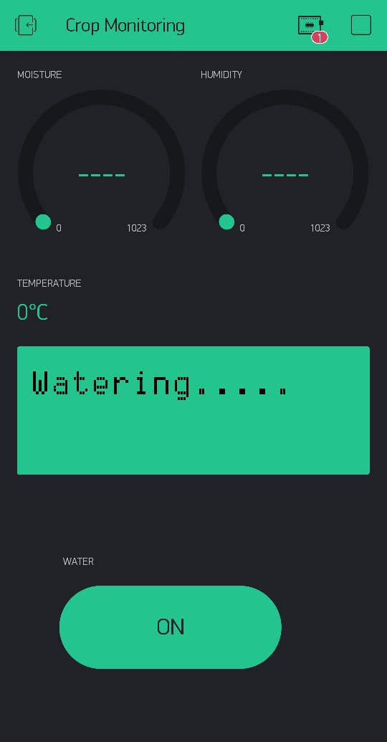
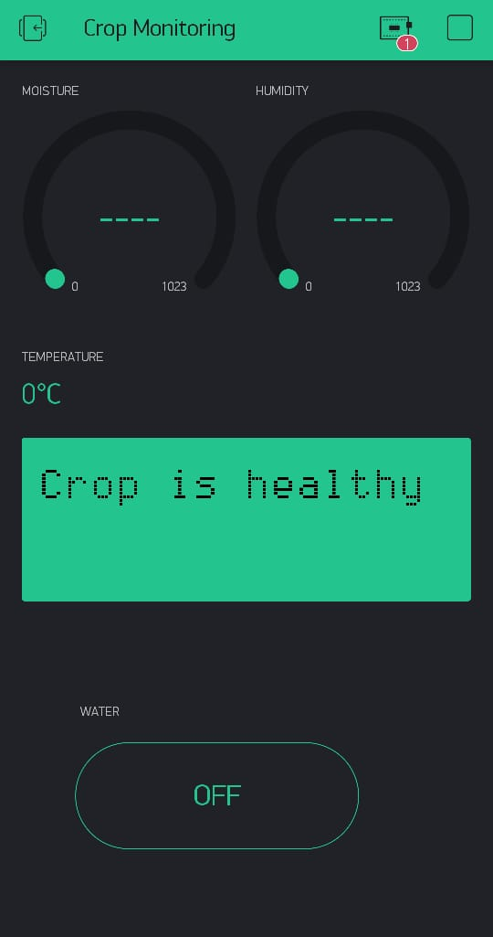
SCREENSHOTS

Slide 15
CODING PART.…

Slide 16
CONCLUSION
The application of agricultural networking technology is need of modern development.
Provides ease to people in controlling irrigation system by applying IoT.
A safe agricultural production has a significant impact on ensuring the effective use of water resources and agricultural production.

Slide 17
THANK YOU.....

